Slide 1
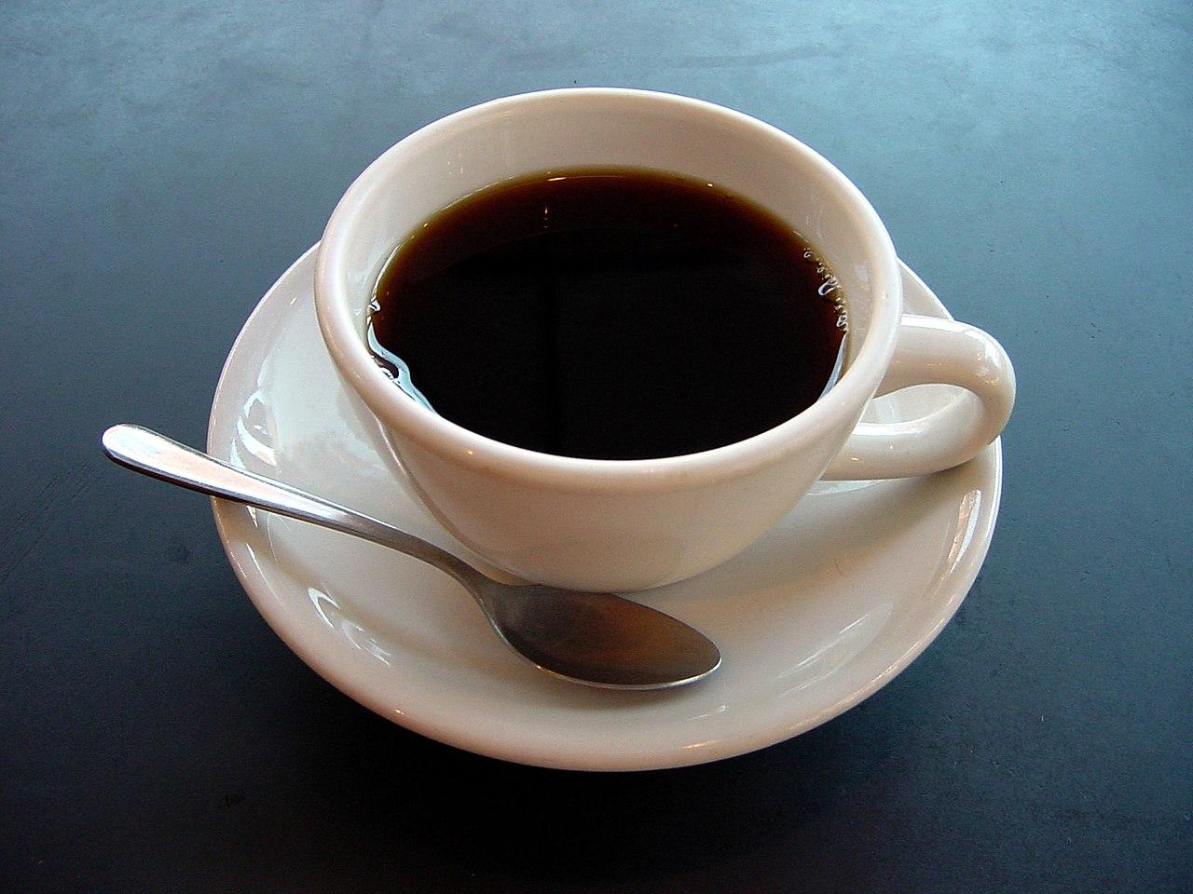
The Perfect Cup of Coffee
By: Rakshit Nune

Slide 2
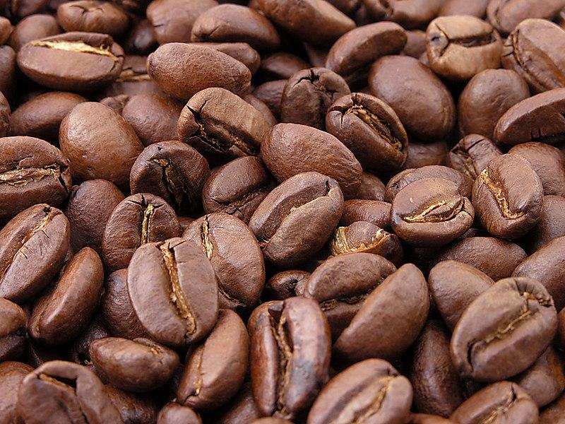
Description and Reasoning
This Project uses the BME680 sensor to determine if the coffee is fresh enough. It use the humidity sensor to determine if it is fresh. To use this device, the user has to place the sensor in an enclosed box or container with the cup of coffee. Then on the serial monitor, it will display whether the coffee is fresh or not by saying “Fresh Coffee” or “Not Fresh Coffee”. This will help employees who work at cafe and coffee shops. In the current world, coffee as become a very high demand product and it is growing. So with the increasing demand, the competition in the coffee industry, so it is essential for cafes and coffee shops to give the best coffee to their customers so they can be in the industry. So this device will be able to determine whether the coffee is fresh which may be difficult without this device. This device will be able to solve this problem.

Slide 3

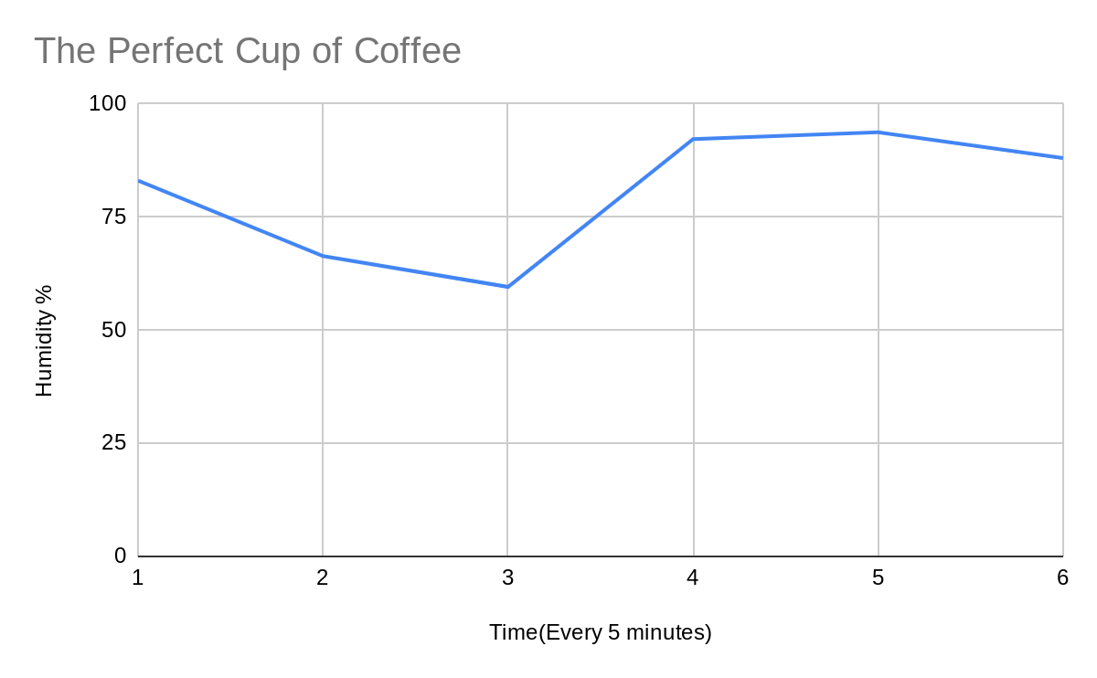
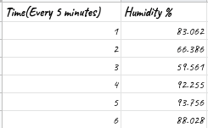
Data

